Slide 1
Geographic Regions
Geographic Region with
Hydrogeographic clusters
(Regional species assemblage)
Hydrogeographic clusters
with HUC12s
Flow Dependent species
ranges from PISCES
(Grantham et al paper)
K-means clustering

Slide 2
Hydrogeographic Clusters
(Regional species assemblage)
Cluster 1 HUC 1:
Fish A
Fish B
Fish C
Fish D
Cluster 1:
Fish A
Fish B
Fish C
Fish D
Cluster 1 HUC 2:
Fish A
Fish B
Fish C
Cluster 1 HUC 3:
Fish A
Fish B
Cluster 2:
Fish A
Fish B
Fish D
Fish E
Cluster 3:
Fish A
Fish B
Fish F
Cluster 3 HUC 3:
Fish A
Fish B
Cluster 3 HUC 2:
Fish A
Fish F
Cluster 3 HUC 1:
Fish A
Fish B
Fish F

Slide 3
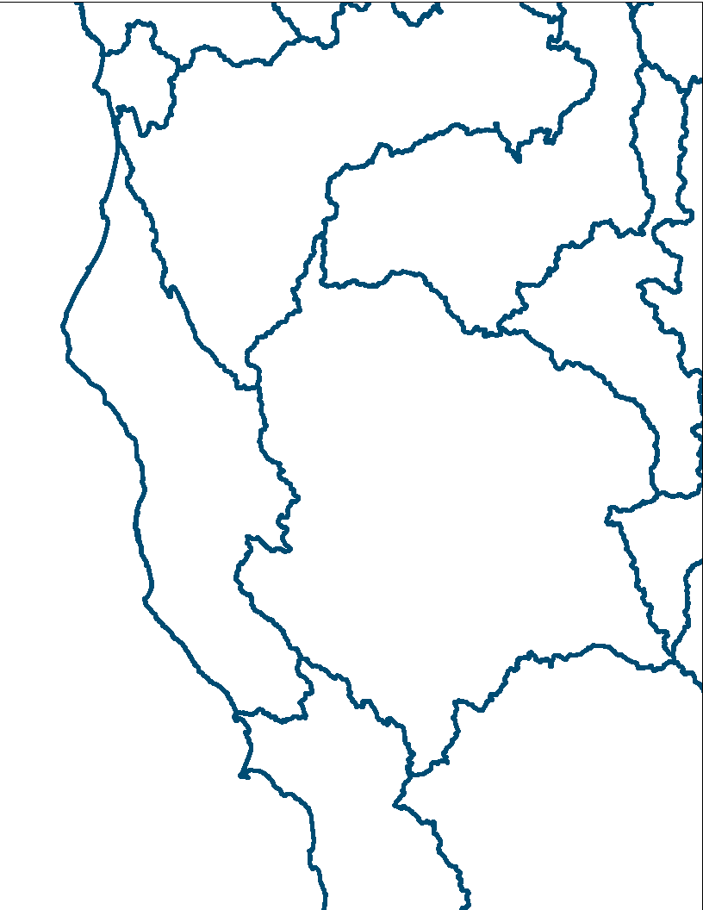
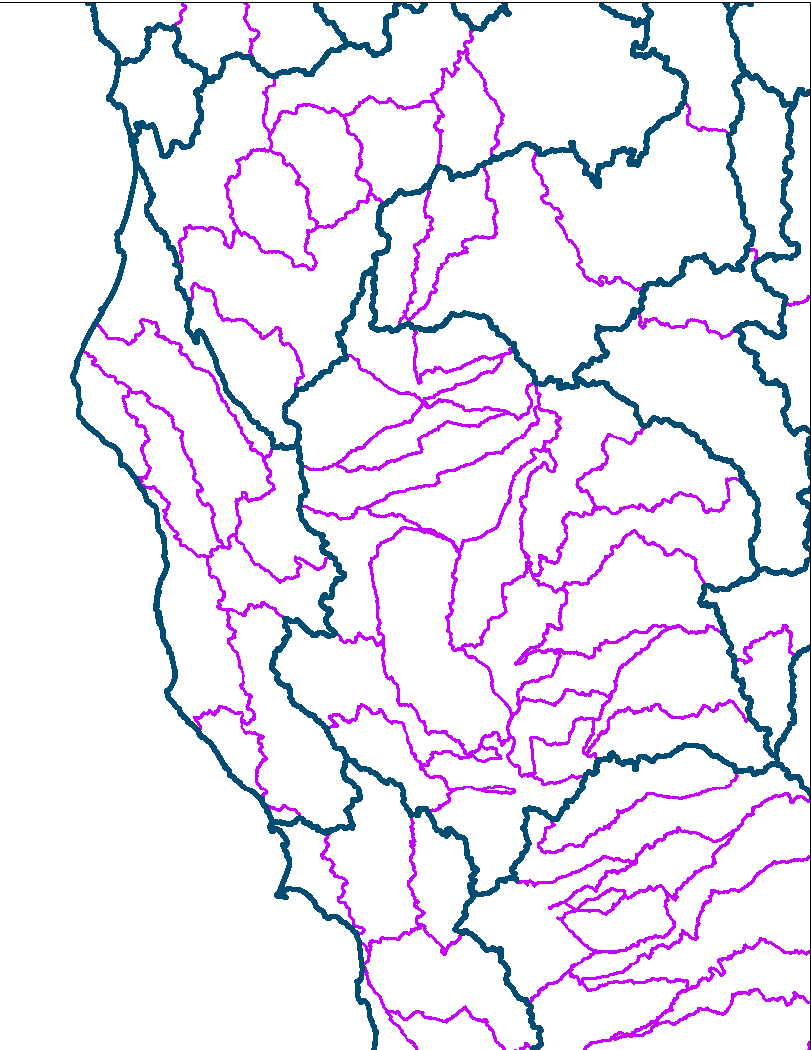
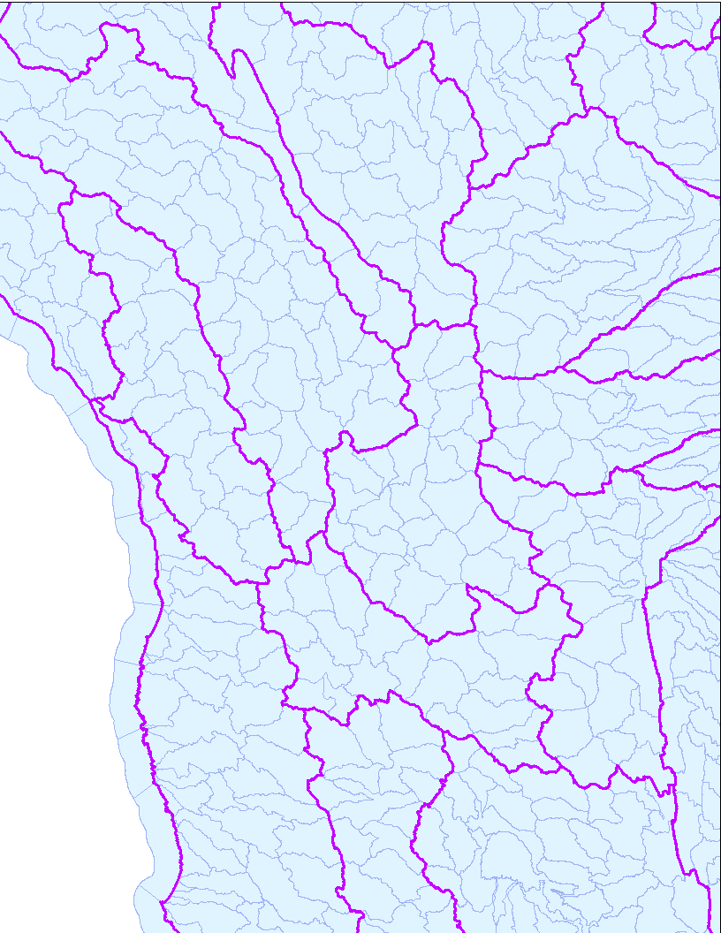
Geographic Regions
Geographic Region with
Hydrogeographic clusters
(Regional species assemblage)
Hydrogeographic clusters
with HUC12s
(potentially misleading as all HUCs)

Slide 4
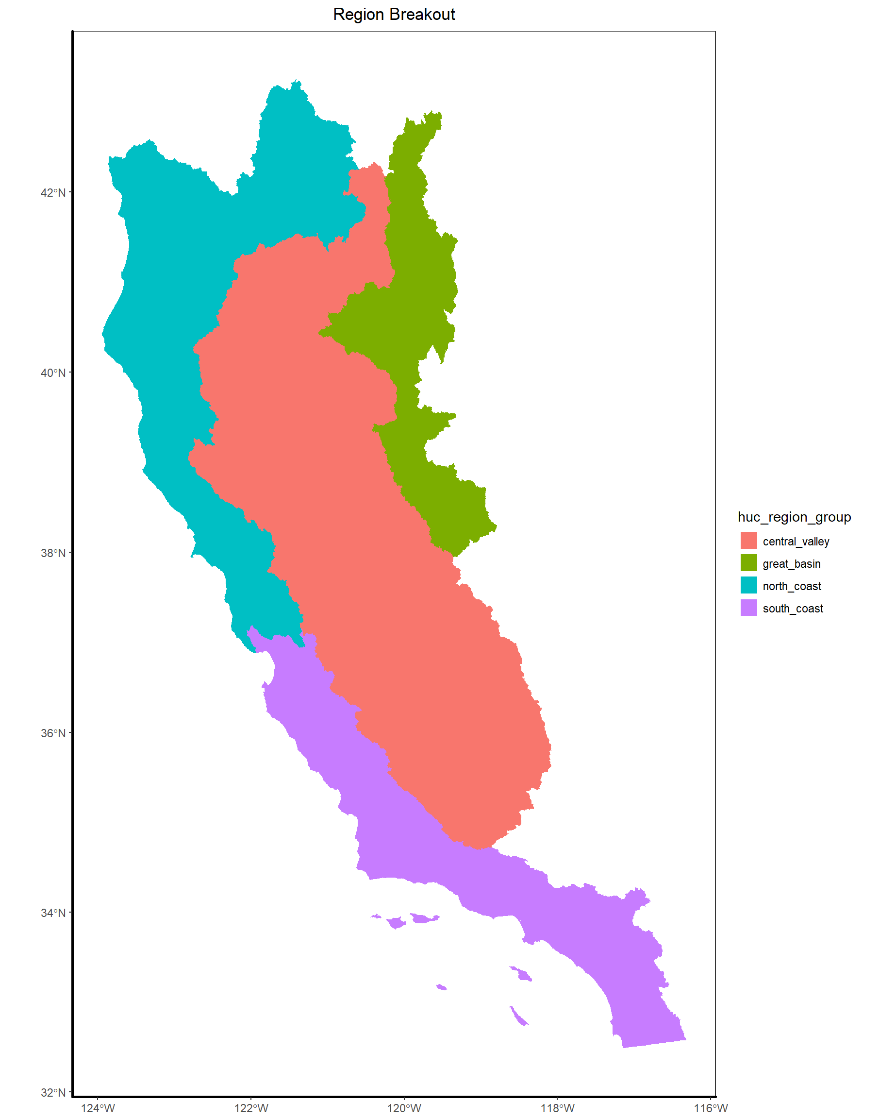
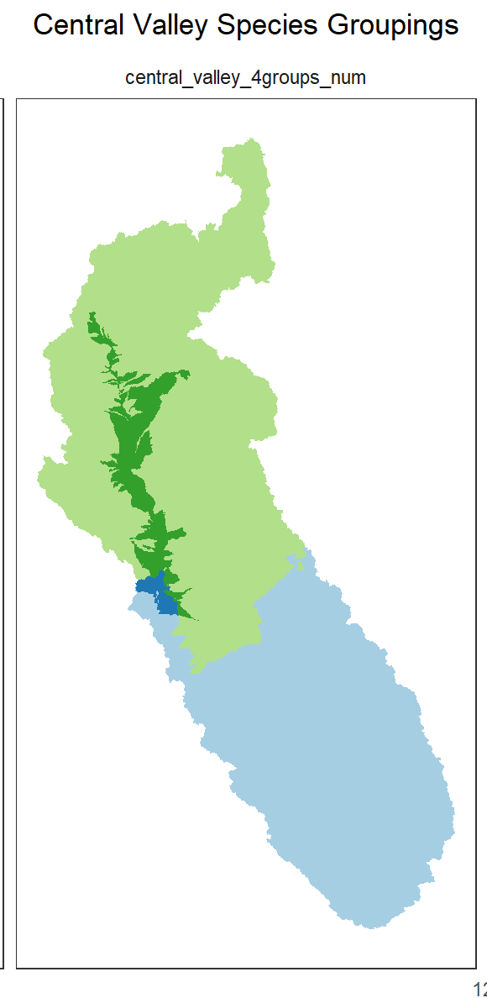
Geographic Regions
San Joaquin:
Salmon
Sac Pikeminnow
Delta Smelt
Kern trout
Kaweah roach
Sacramento:
Salmon
Sac Pikeminnow
Delta Smelt
Red hill roach
Modoc sucker
Pit sculpin
Sacramento Main:
Salmon
Sac Pikeminnow
Delta Smelt
Delta
Salmon
Sac Pikeminnow
Delta Smelt
Longfin smelt
Wide-ranging generalist:
Salmon, pikeminnow
Local endemic:
Kaweah roach, modoc sucker

Slide 5
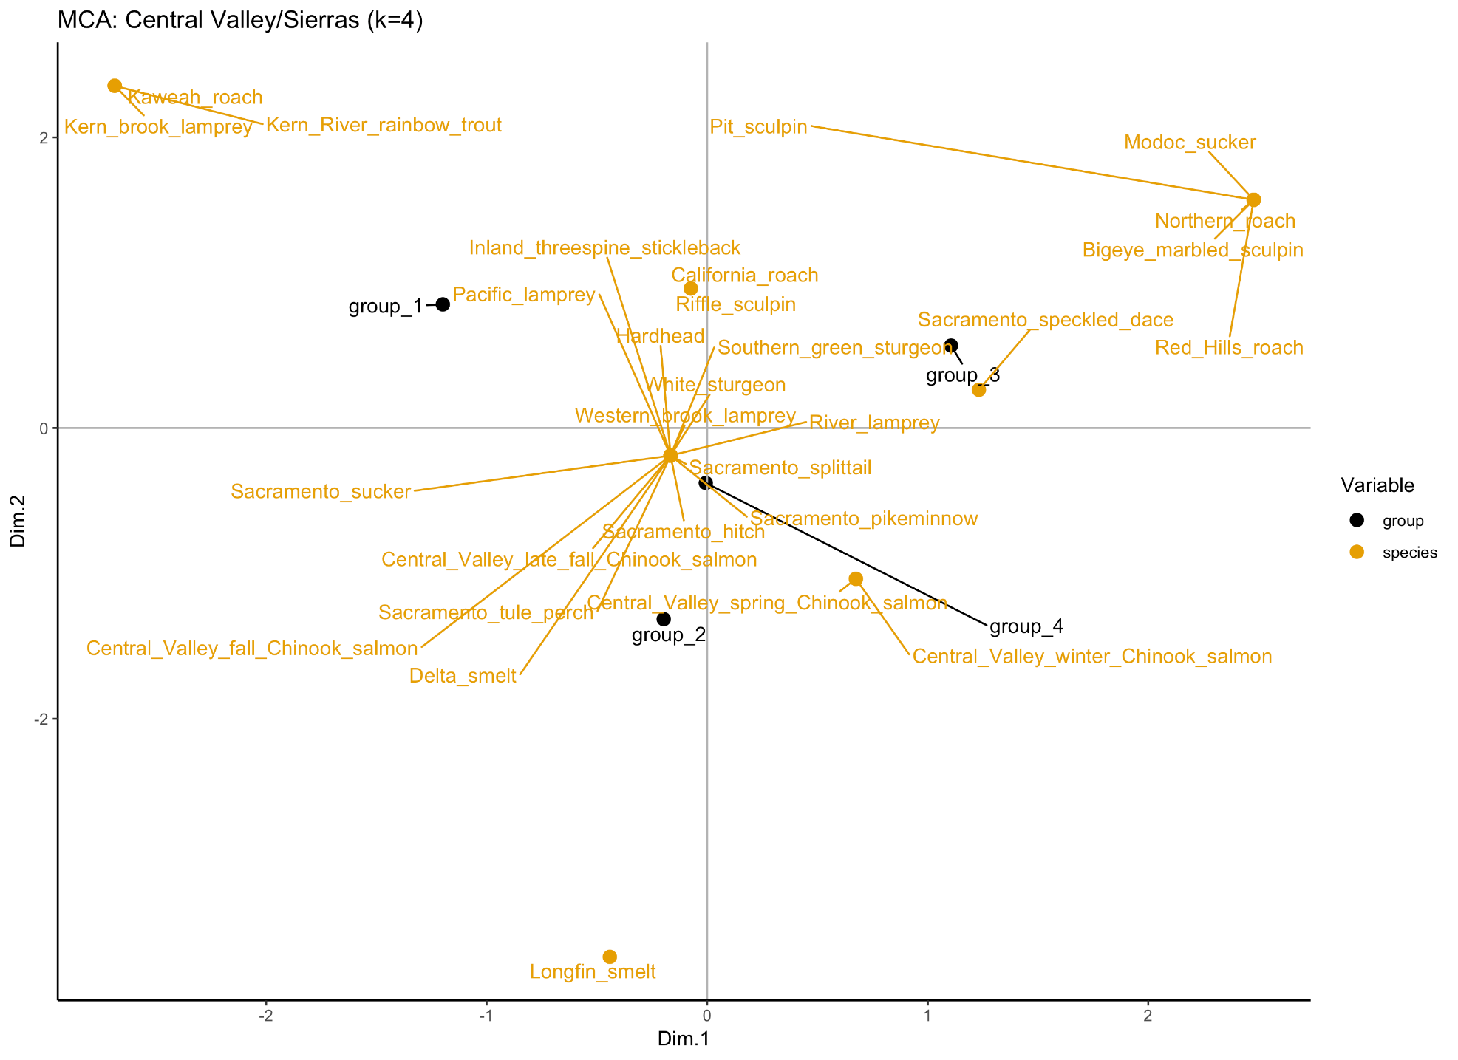

Slide 6
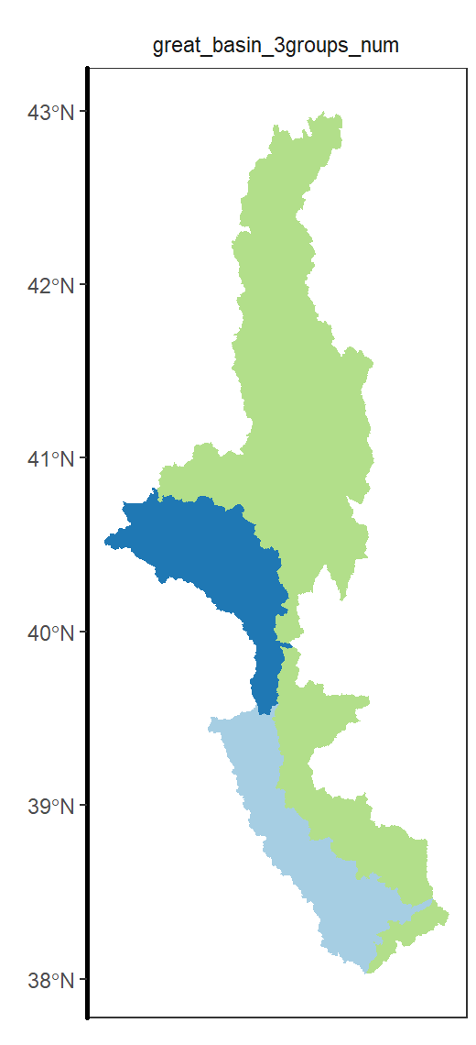
Geographic Regions
Great Basin (green):
Lahontan dace
Lahontan sucker
Sac speckled dace
Honey Lake area:
Lahontan dace
Lahontan sucker
East Side Sierras:
Lahontan dace
Lahontan sucker
Lahontan trout
Mountain whitefish

Slide 7
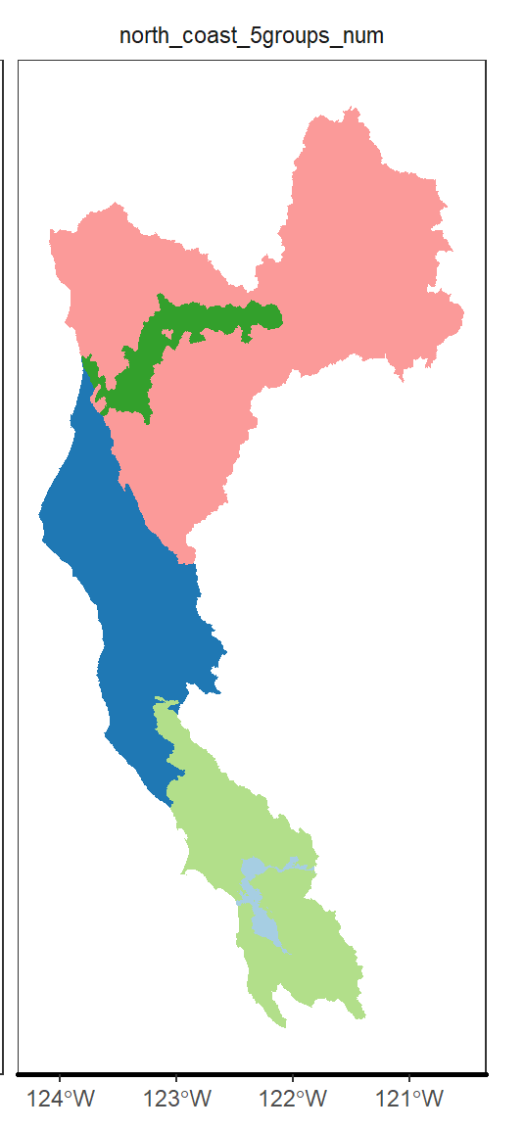
Geographic Regions
Upper Klamath:
Klamath species
Klamath suckers
Pacific lamprey
Klamath main:
Klamath species
Pacific lamprey
North coast:
Sac pikeminnow/sucker
Pacific lamprey
Coastal salmon/steelhead
hardhead
Bay Area:
Sac pikeminnow/sucker
Pacific lamprey
Coastal salmon/steelhead
CA roach
SF Bay:
Sac hitch/splittail
Pacific lamprey
Central Valley salmon
Wide-ranging generalist:
Pacific Lamprey
Local endemic:
Blue chub, shortnose sucker

Slide 8
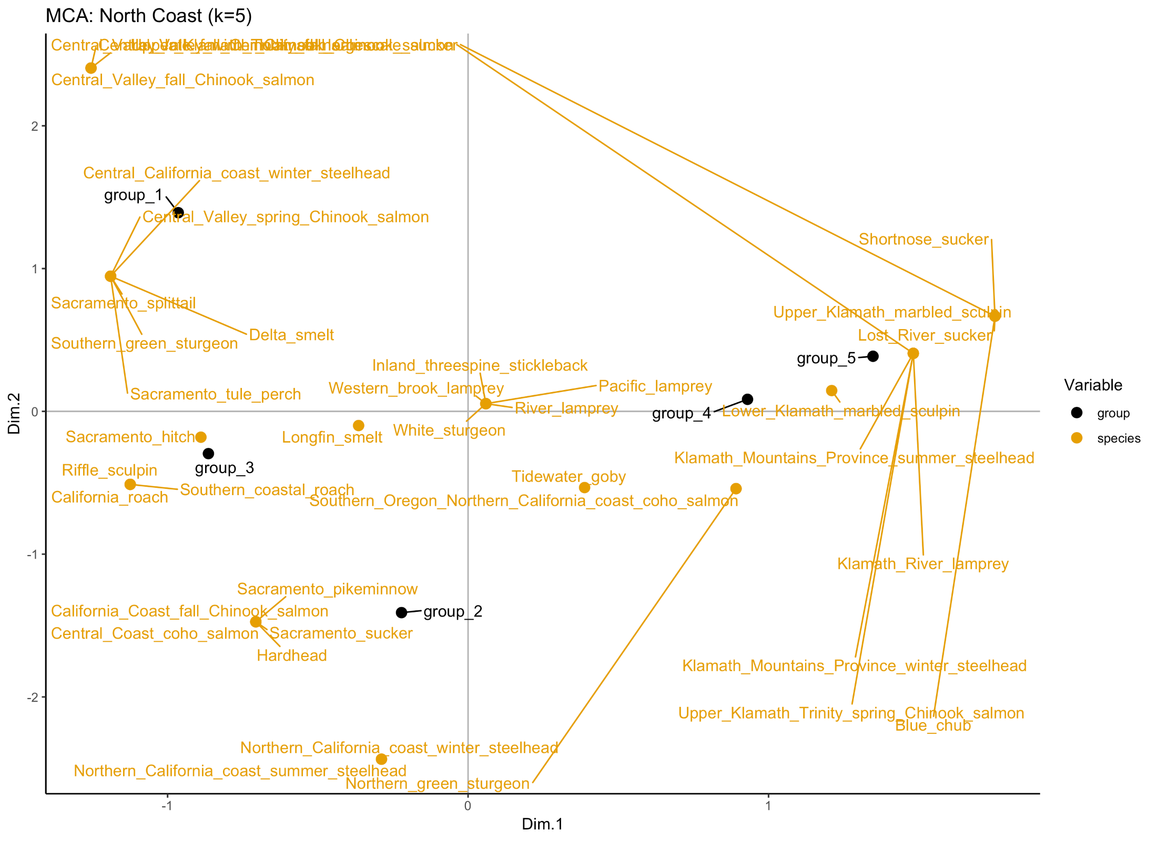

Slide 9
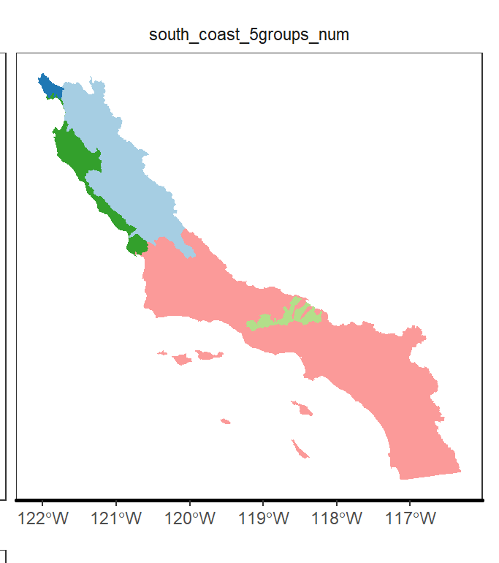
Geographic Regions
Santa Cruz:
Central coast winter steelhead
South Central inland:
Monterey sucker
Riffle sculpin
Sac pikeminnow
South Central coast:
Monterey sucker
Sac pikeminnow
South Coast:
Santa Ana sucker
Arroyo chub
So Cal steelhead
South inland mountains:
Unarmored threespine stickleback
So Cal steelhead
Wide-ranging generalist:
Pacific Lamprey
Local endemic:
Arroyo chub, santa ana sucker

Slide 10
